Slide 1
Lecture 6: Overfitting and Regularization
Instructor: Xiaobai Liu

Slide 2
Key question to Machine Learning
We are concerned about the generalization performance, i.e. how well a machine learning model works on new unseen samples
This gives us a criteria to select one model instead of others
A model is defined as: a specific machine learning method (e.g., linear regression) or specific choices of hyper-parameters (e.g., learning rate)

Slide 3
Conti.
In a particular dataset, we might find one model is better than the other, this does not means general superiority
We need to focus on the assumptions, priors, the data and the cost, i.e. the current situation you have.

Slide 4
Outline of this lecture
Bias-Variance
Regularization

Slide 5
Outline of this lecture
Bias-Variance
Regularization

Slide 6
Judging model performance
This lecture is to make it more clear about how we judge model performance
Consider performance on I.I.D test dataset

Slide 7
Bias-Variance Dilemma during training
Bias over predictions is defined over the differences between the expected values and the true values
A low bias means that on average we will accurately estimate the model
Variance over predictions indicates how much the model estimates change as the training set varies.

Slide 8
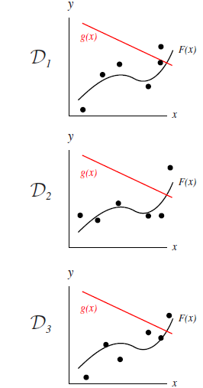
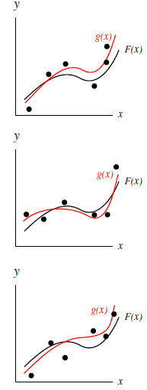
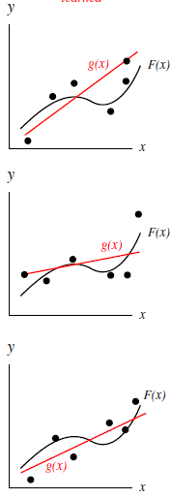
Bias-Variance Dilemma: Regression
High Bias, low Variance
Low Bias, High Variance
Low Bias, Low Variance

Slide 9
Diagnosing bias and variance
Validation Method
Randomly split the training dataset into two subsets, one for training and the other for validation.
Observe that your learning algorithm is performing less well
If both validation errors and training errors are equally high, you are likely to encounter high bias (under-fit)
If training error is low but validation error is high, you might encounter high variance (over-fit)

Slide 10
Conti.
A more advanced evaluation method is Cross Validation:
Randomly split training dataset multiple times
For each split, calculate the loss/errors
Average loss/errors over all splits.
Most stable due to full access to all training samples

Slide 11
Outline of this lecture
Bias-Variance
Regularization

Slide 12
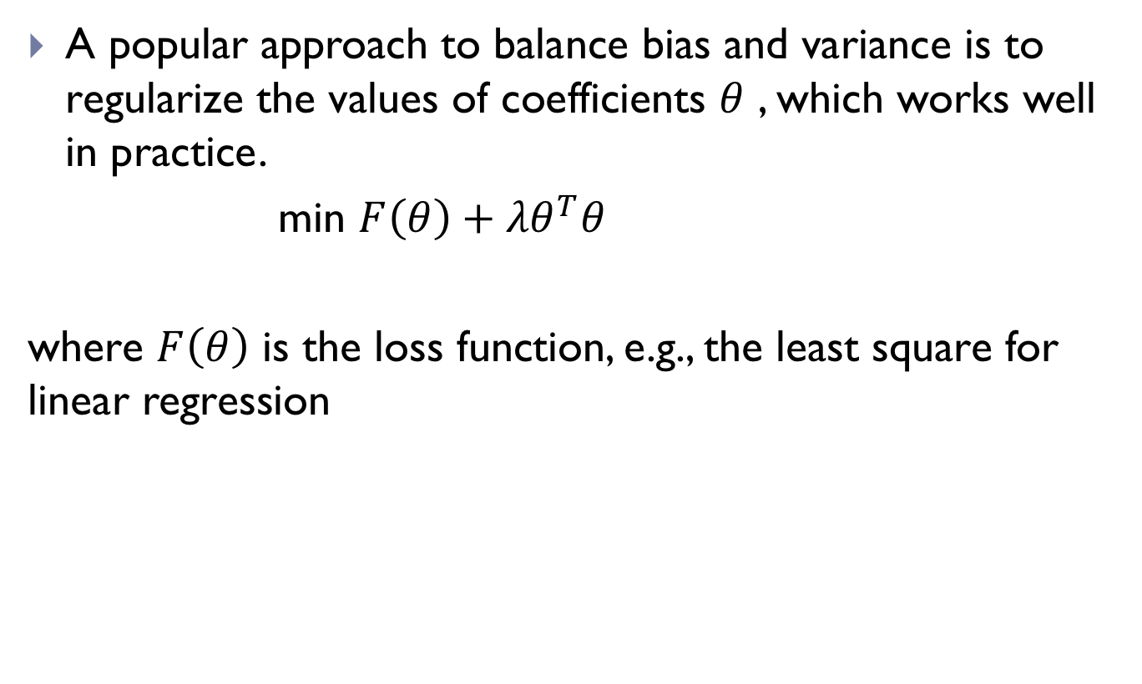
Regularization
A popular approach to balance bias and variance is to regularize the values of coefficients $θ$ , which works well in practice.
min ${F\left(θ\right)+λθ}^{T}θ$
where $F\left(θ\right)$ is the loss function, e.g., the least square for linear regression

Slide 13
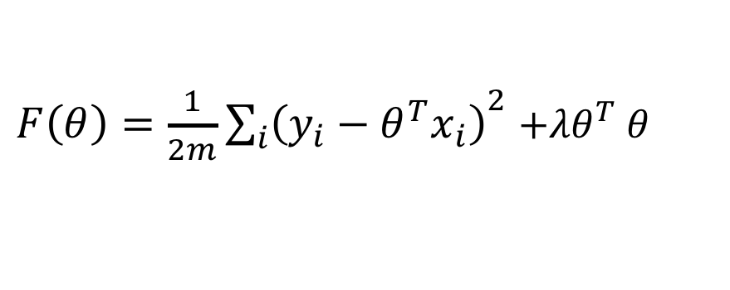
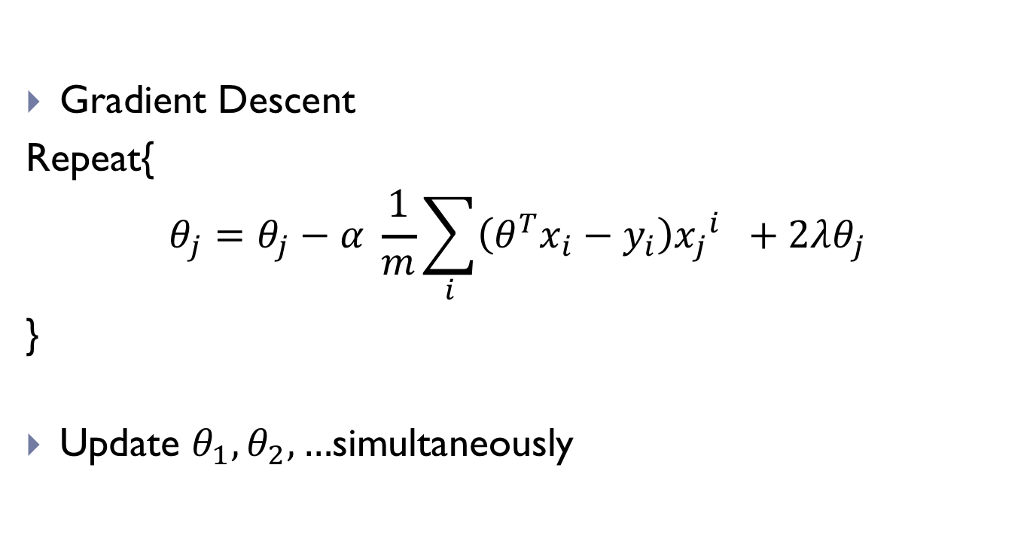
Regularized Regression: Learning
Cost Function
$F\left(θ\right)=$ $\frac{1}{2m}{\sum_{i}{\left(y_{i}−θ^{T}x_{i}\right)}}^{2}{+λθ}^{T}θ$
Gradient Descent
Repeat{
$$θ_{j}=θ_{j}−α \frac{1}{m}\sum_{i}{\left(θ^{T}x_{i}−y_{i}\right){x_{j}}^{i} }+2λθ_{j}$$
}
Update $θ_{1},θ_{2},…$simultaneously

Slide 14

Factors that affects Bias and Variances
Regularization parameter $λ$
Sample size
Model Complexity

Slide 15

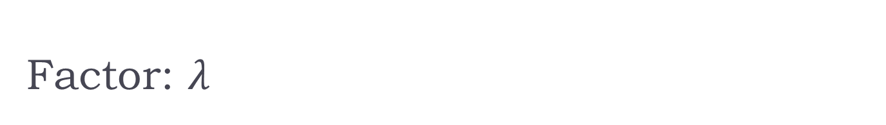

Factor: $λ$
If $λ$ is too small, over-fit to training samples; if the training samples change, the optimal model will change accordingly, i.e. high Variance
If $λ$ is too big, under-fit, High bias (large errors)
Cross-validation
Errors
Training
$$λ$$

Slide 16
Factor: Sample size
If the sample size is too small,
you have better chance to fit training samples well
Since you cannot train your model well, you might get large validation errors
Errors
Cross-validation
Errors
Training
Training set size

Slide 17
Conti.
If the training sample size is too big,
You have difficulties to fit all samples – high bias for simple model, but it’s ok if use more complex model (e.g. CNN).
Validation Errors could be reduced if your model is with high variance
However, it won’t help you if your model is with high bias
Errors
Cross-validation
Errors
Training
Training set size

Slide 18
Quiz
If your model suffers from high variance, which method will help
Getting more training data
Getting less training data
Neither

Slide 19
Factor: model complexity
If your model is simple (e.g. only 2 parameters to estimate),
Bias is usually high since the model cannot fit data well;
Variance tends to be low
If your model is complex,
prediction bias is usually low, fit training data well
prediction variance is relatively high, the learnt model doesn’t work well.

Slide 20
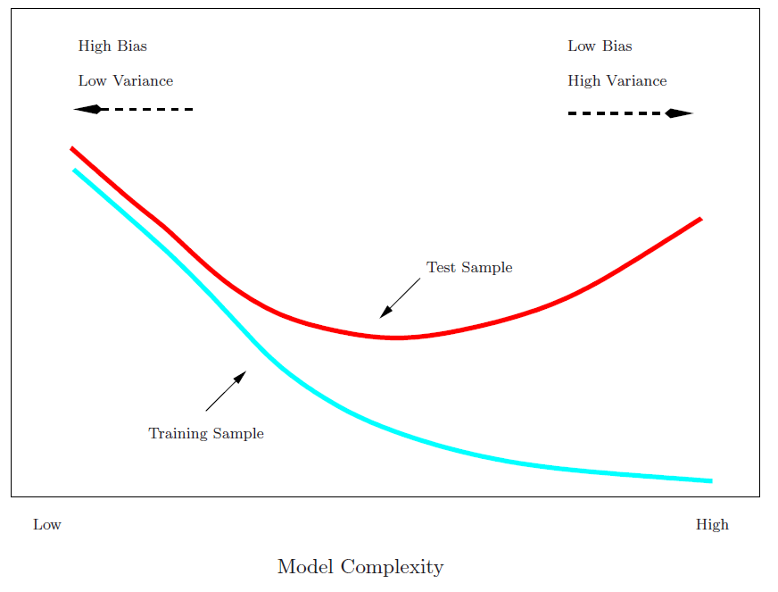
Conti
We like to minimize the gap between these two learning curves

Slide 21
Outline of the rest
Case study: Regularization
Boston Housing dataset
To predict the median value of homes in several Boston neighborhoods
Feature predictors: crime rate, proximity to the Charles River, highway accessibility, etc.
506 data points, 13 features

Slide 22
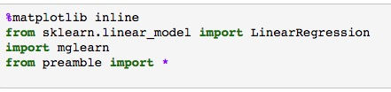

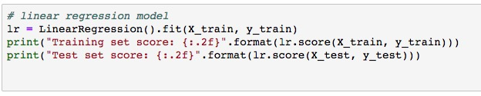

Case A: Linear Regression
Import libraries
Load dataset
Training

Slide 23
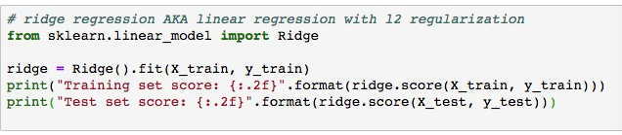

Case B: Ridge Regression (L2 regularization)
Previous Results (without regularization)
Ridge Regression
New Results ( worse training score, better testing score)

Slide 24
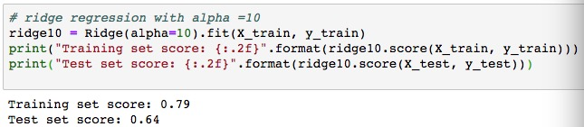
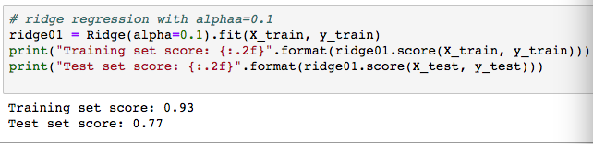
Case B: Ridge Regression (L2 regularization)
Training with different regularization weights (alpha below)

Slide 25
Source codes available
Lecture-LinearRegression.ipynb

Slide 26
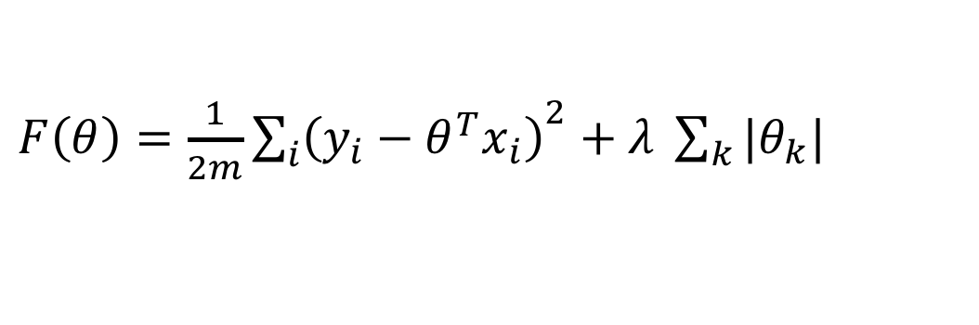
LASSO: L1 Regularization (Optional)
Instead of L2 terms, using L1 norm to regularize model parameters
$F\left(θ\right)=$ $\frac{1}{2m}{\sum_{i}{\left(y_{i}−θ^{T}x_{i}\right)}}^{2}+λ \sum_{k}{|θ_{k}|}$
Still use Gradient Descent during training
Sub-gradients (introduced in later sections)
Encourage sparsity over the learned coefficients
Codes available in Lecture LinearRegression.ipynb as well

Slide 27
Summary
Bias-variance dilemma
Three major factors
Regularization parameter
Training sample size
Model complexity

